Slide 1
Marketing

Slide 2

What is Marketing?
Marketing are activities of a company associated with buying and selling a product or service. It includes advertising, selling and delivering products to people.
Marketing is everything a company does to acquire customers and maintain a relationship with them.
Marketing is based on thinking about the business in terms of customer needs and their satisfaction.
The four P’s of marketing, which are considered integral to the whole structure and organisation of marketing, are:
identification, selection and development of a product
determination of its price
selection of a distribution channel to reach the customer's place
development and implementation of a promotional strategy.

Slide 3
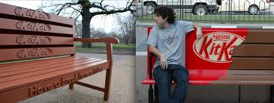
Creativity: An aspect of Marketing

Slide 4
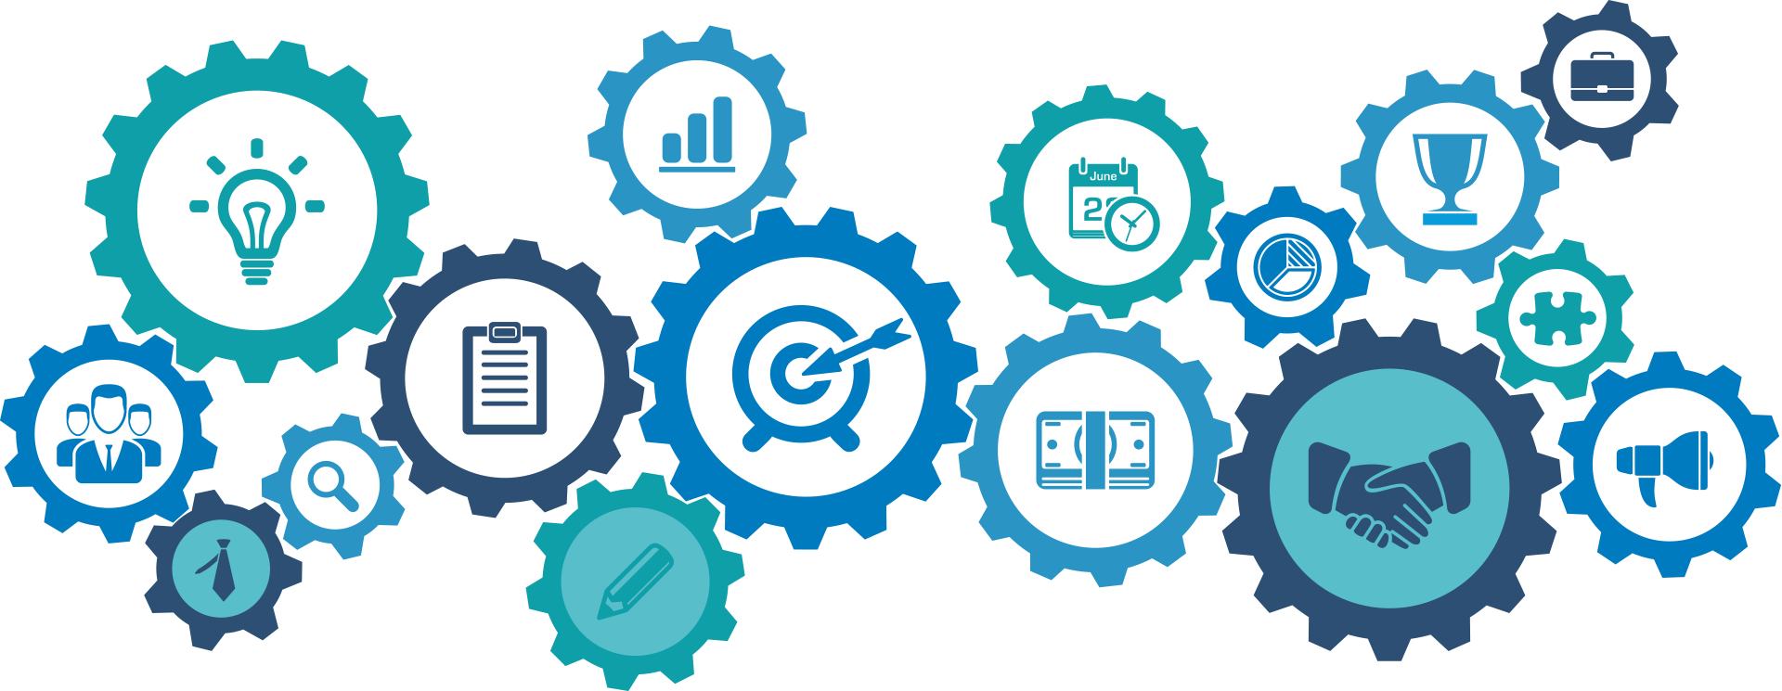
Why is Marketing significant?
Marketing is often mistook for advertising. It is much more intricate than that. It involves multiple layers of study, research, brain-storming, ideating and implementation. Marketing is important, especially for start-ups and new businesses, for the following reasons:
Spreads your Brand’s name and establishes its Identity.
Differentiates your product from the competition's .
Helps gain and retain customers and ensures longevity (long life) to them.
Creates avenues for development of the Brand/product/service.

Slide 5
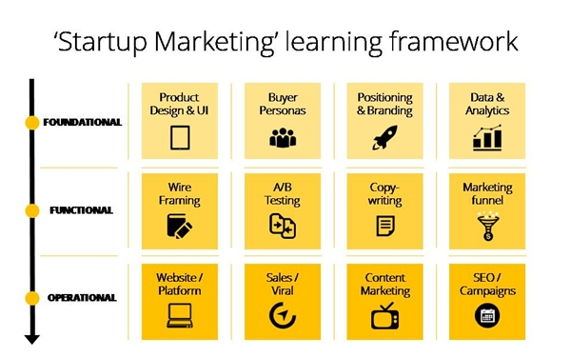

Slide 6
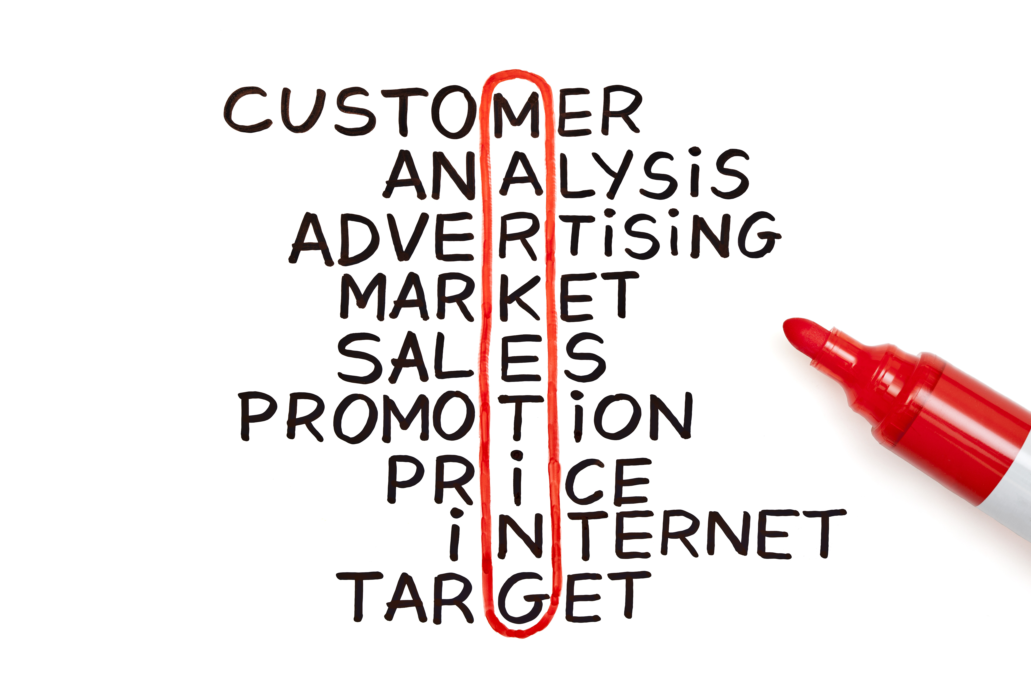
Terminologies and Jargons
There is a plethora of terminologies concerned with the aspect of Marketing. These help define different methodologies, ideals, marketing practices etc. which are often followed and implemented throughout the marketing procedures. We will explain in crisp detail these terminologies in the following slides, as they are indispensable features of the Marketing world.

Slide 7

Demographics
Demographics is the statistical study of a population based on factors such as age, race and sex, among others.
Understanding the demographics of your target customers is critical for the success of your business. Not only do you need to understand them in order to decide exactly what your product and services mixes will include, but this information will also affect pricing, packaging, promotion and place.
Various factors such as Purchasing power, Residences, Means of transportation, Age ranges, Family status, Leisure activities, etc. are considered.
Demographic study aids in lowering marketing costs, identifying new opportunities, understanding the ideal customer, creating unique selling points and a consequent increase in sales.
Notes:
Patanjali products Demographic case study - http://library.pes.edu/opac/Casestudy.pdf
Apple Inc. product demographic study - https://research-methodology.net/apple-segmentation-targeting-and-positioning/#_ftn1
10 Demographic Trends that are shaping the world - http://www.pewresearch.org/fact-tank/2016/03/31/10-demographic-trends-that-are-shaping-the-u-s-and-the-world/

Slide 8
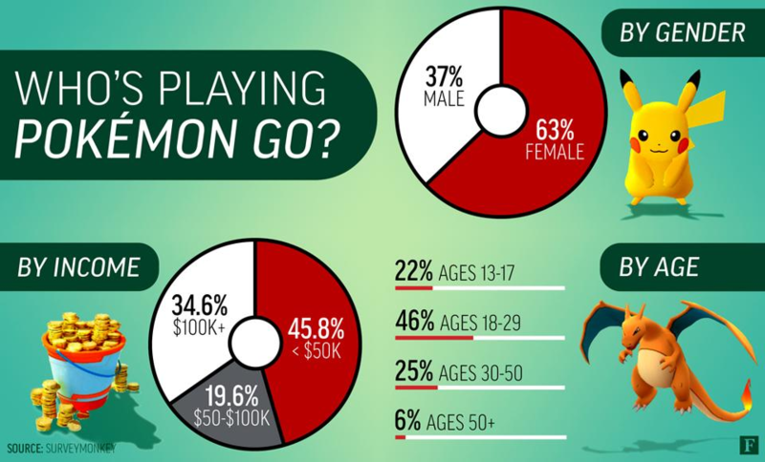

Slide 9

Defining your Target Market
No one can afford to target everyone. Small businesses can effectively compete with large companies by targeting a nice market.
Target marketing allows you to focus your marketing dollars and brand message on a specific market that is more likely to buy from you than other markets. This is a much more affordable, efficient, and effective way to reach potential clients and generate business.
Look at your current customer base.
Check out your competition.
Analyse your product/service.
Tap existing resources like Google Trends, Quantcast or Ahrefs and conduct your own primary research on survey websites, focus groups etc.
Choose specific demographics to target.
Consider the psychographics of your target.

Slide 10
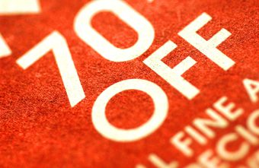
Penetration Pricing
Penetration pricing is the practice of offering a low price for a new product or service during its initial offering in order to lure customers away from competitors.
This marketing strategy relies on the idea that low prices can help make a customer aware of and more willing to buy a new product.
It can often increase both market share and sales volume. The high sales volume can also lead to lower production costs and higher inventory turnover.
The increase in sales volume may not necessarily lead to a profit if prices are kept too low. As well, if the price is only an introductory campaign, customers may switch out of curiosity but then leave the brand once prices begin to rise to levels more in line with rivals.
Notes:
Penetration Pricing Examples - http://www.intelligencenode.com/blog/5-best-penetration-pricing-examples/
Walmart Pricing Strat- http://www.investopedia.com/articles/personal-finance/011815/how-walmart-model-wins-everyday-low-prices.asp

Slide 11

Price Skimming
Price skimming is a pricing strategy whereby businesses set high prices for their product or service during the introductory phase.
Price Skimming aims at reaching a segment of the market which is relatively price insensitive. The firm sells its product at a high price in the segment of the market which is willing to pay a premium price for the value received.
Skimming enables the marketer to recoup the investment quickly. It allows him to meet development expenses in a short span.
This strategy establishes a strong presence of the brand, assures quality of the product, attracts status conscious customers.

Slide 12
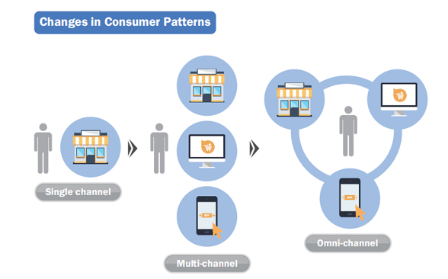
Distribution Channel
A distribution channel is a chain of businesses or intermediaries through which a good or service passes until it reaches the end consumer. It can include wholesalers, retailers, distributors and even the internet itself.
To choose the best distribution channel for a product, a variety of factors like the nature of the product, the market, the business, legal issues and others are to be considered.
A highly optimised distribution channel is extremely beneficial to the business.
Notes:
Cisco distribution Channel benefits - http://searchitchannel.techtarget.com/news/2240227367/Sage-Cisco-partners-benefit-from-vendor-distributor-partnerships

Slide 13
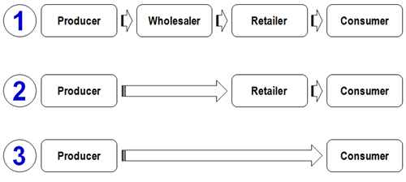

Slide 14
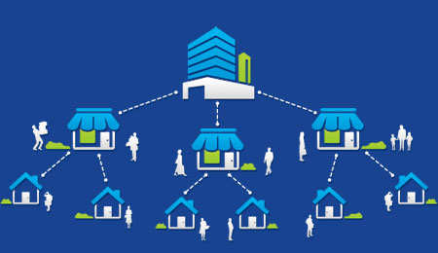
Franchise
A franchise is a type of license that a party (franchisee) acquires to allow them to have access to a business's (the franchiser) proprietary knowledge, processes and trademarks in order to allow the party to sell a product or provide a service under the business's name.
In exchange for gaining the franchise, the franchisee usually pays the franchiser initial start-up and annual licensing fees.
New franchisees can avoid a lot of the mistakes start-up entrepreneurs typically make because the franchisor has already perfected daily operations through trial and error.
Most franchisors have comprehensive marketing plans in place for the overall franchise. The plan typically includes advertising campaigns, commercials via television and radio, Internet advertising, social media, public relations, and direct mail efforts; therefore, brand recognition is widely established, and franchisees benefit from this brand equity.

Slide 15
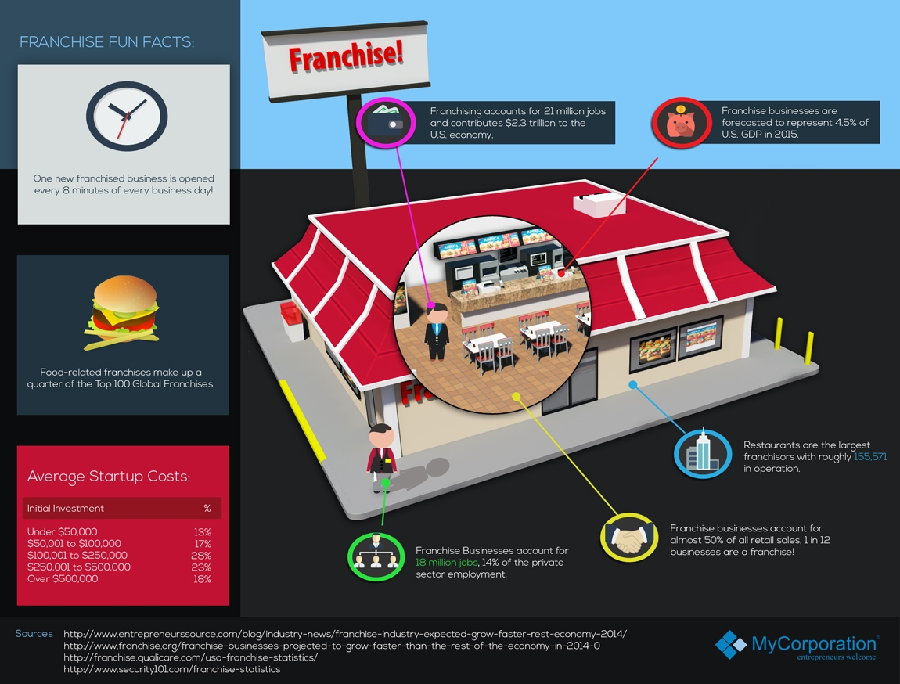

Slide 16
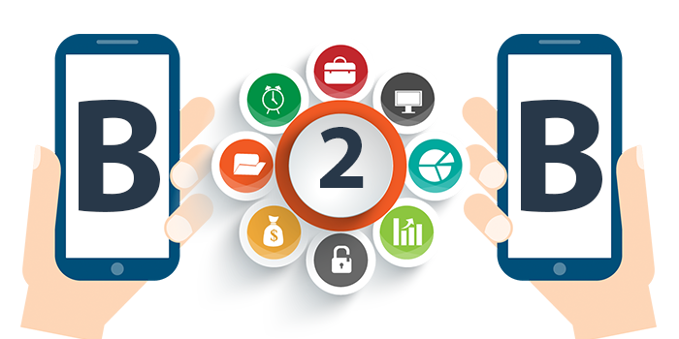
Business to Business(B2B)
Business-to-business marketing (or B2B marketing) involves the sale of one company’s product or service to another company. At its core, B2B marketing involves building valuable relationships to guarantee lasting customers.
B2B marketing techniques rely on the same basic principles as consumer marketing, but are executed in a unique way. While consumers choose products based not only on price but on popularity, status, and other emotional triggers, B2B buyers make decisions on price and profit potential alone.
The B2B market is the largest of all the markets, and exceeds the consumer market in dollar value. Companies like GE and IBM spend an estimated $60 million a day on goods that support the operation of their business.
A B2B marketer can effectively put their product or service into the right hands by positioning their offering in an exciting manner, understanding the customer’s needs, and proposing the right solutions to combine the two.

Slide 17
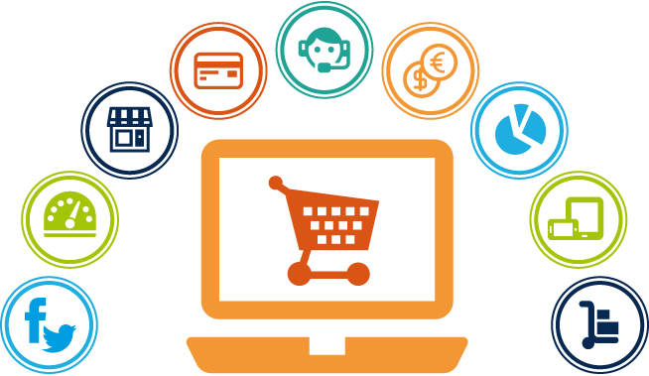
Business to Consumer(B2C)
Business to consumer (B2C) is business or transactions conducted directly between a company and consumers who are the end-users of its products or services.
While it applies to any type of direct-to-consumer selling, it has come to be associated with online selling, also known as ecommerce or e-tailing.
The goal is to match the marketing message with the target consumer segment, since different consumer segments will respond differently to various marketing methods.
B2C marketing is most effective with customers who have already had a positive experience with the product or company. Happy customers are more likely to buy more and to refer the product to their friends. Repeat business is the key to a successful, growing business, and B2C marketing practices work to build customer loyalty.

Slide 18
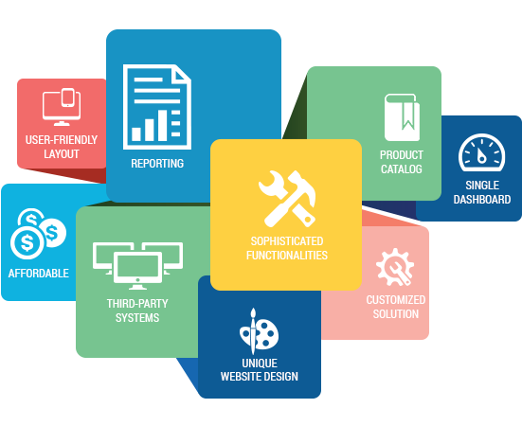

Slide 19
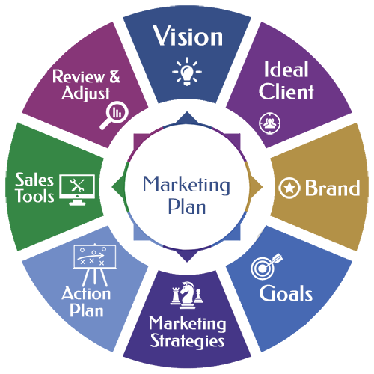
Marketing Plan 101
The success of a start-up will often depend on its approach to marketing.
A Marketing plan provides the overall, high level strategy based on the business’s objectives over a period of time while a Marketing campaign is a focused, tactical initiative to achieve a specific marketing goal.
Pick your target audience: Who are you interested in attracting?
Set your goals and KPIs(Key Performance Indexes): What do you want to accomplish with this campaign and how will you measure performance?
Determine your offer: What incentive will get their attention?
Identify your channel: What media channels will you use to promote this offer?
Create your optimized landing page: How will you get the visitor to take action?
Nurture the lead: How do you help your visitors with their buying journey?
Track and measure results: How will you measure success?

Slide 20

Disruptors in the Marketing World
Many Chinese smartphone manufacturers save billions of dollars and humongous amounts of effort in Research and Development by simply getting inspiration from some other smartphone giants like Apple, Samsung or LG. This is very beneficial, as they simply learn from the best and implement it in their own ways, maybe even improving upon the ideas.
In such a way, we can learn and get inspired by many such leaders and pioneers of the marketing world by taking up their examples.
Following are some such examples of products, advertisements, marketing campaigns, strategies and plans which took the marketing and the world by storm.

Slide 21
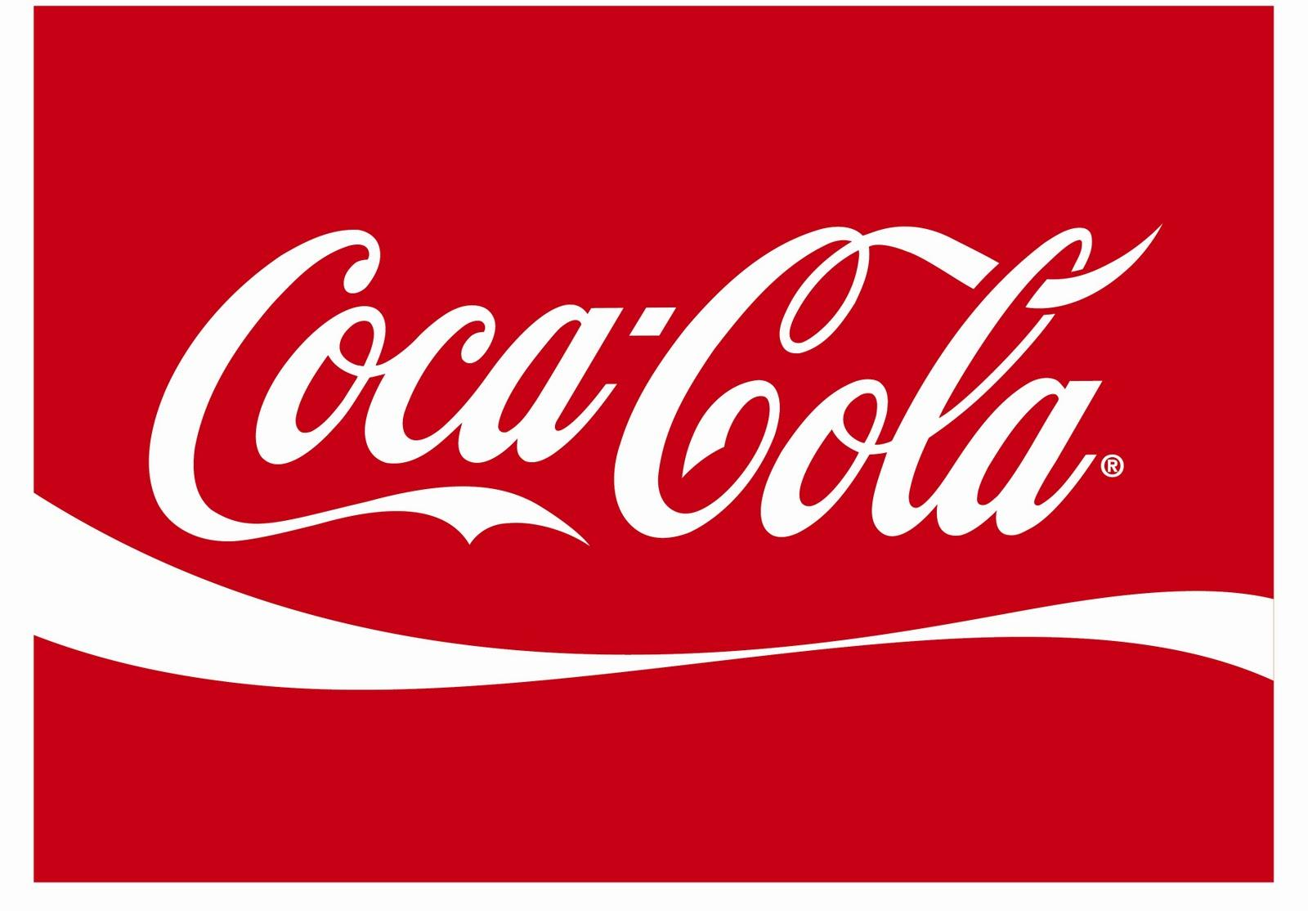
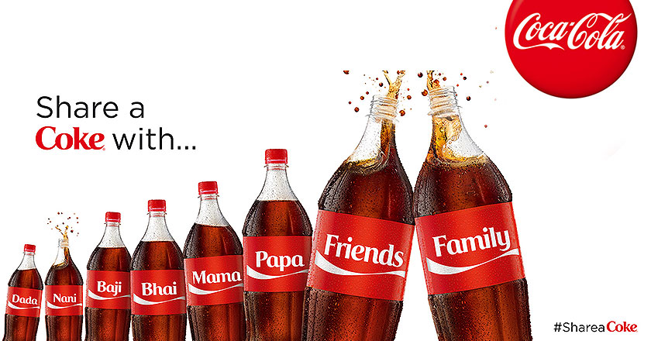
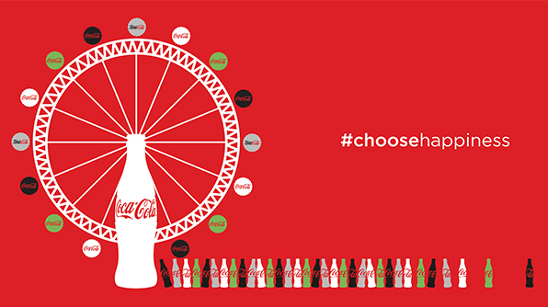
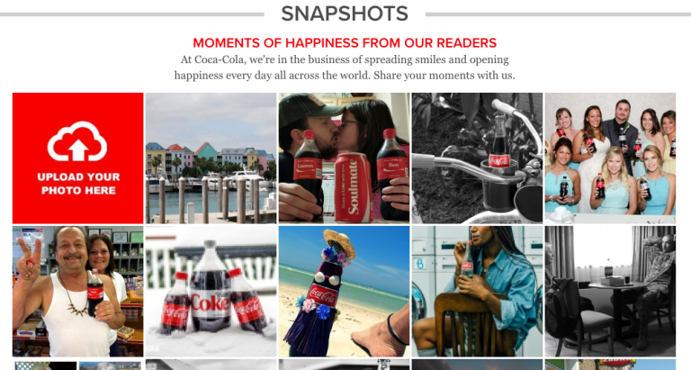
Coca-Cola
As the most recognizable brand in the world, Coca-Cola certainly knows a thing or two about successful global marketing. At over a century old, Coke remains an industry leader both in product sales and marketing. Simple, personalised, socialised and a good experience, such are the words that come to mind about Coke marketing. In its Share-a-Coke campaign, the beverage company managed to make each person who picked up a can feel special and unique.

Slide 22

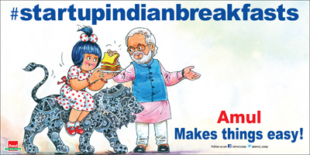
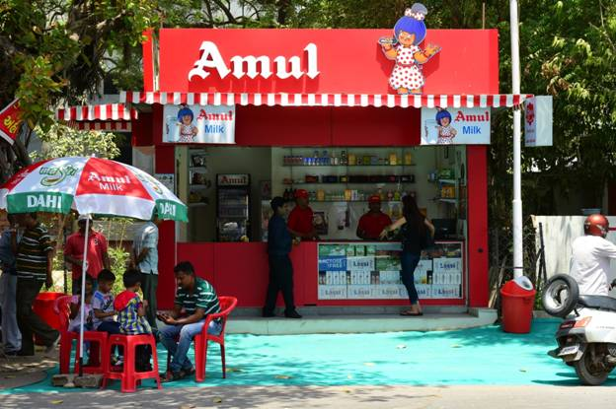
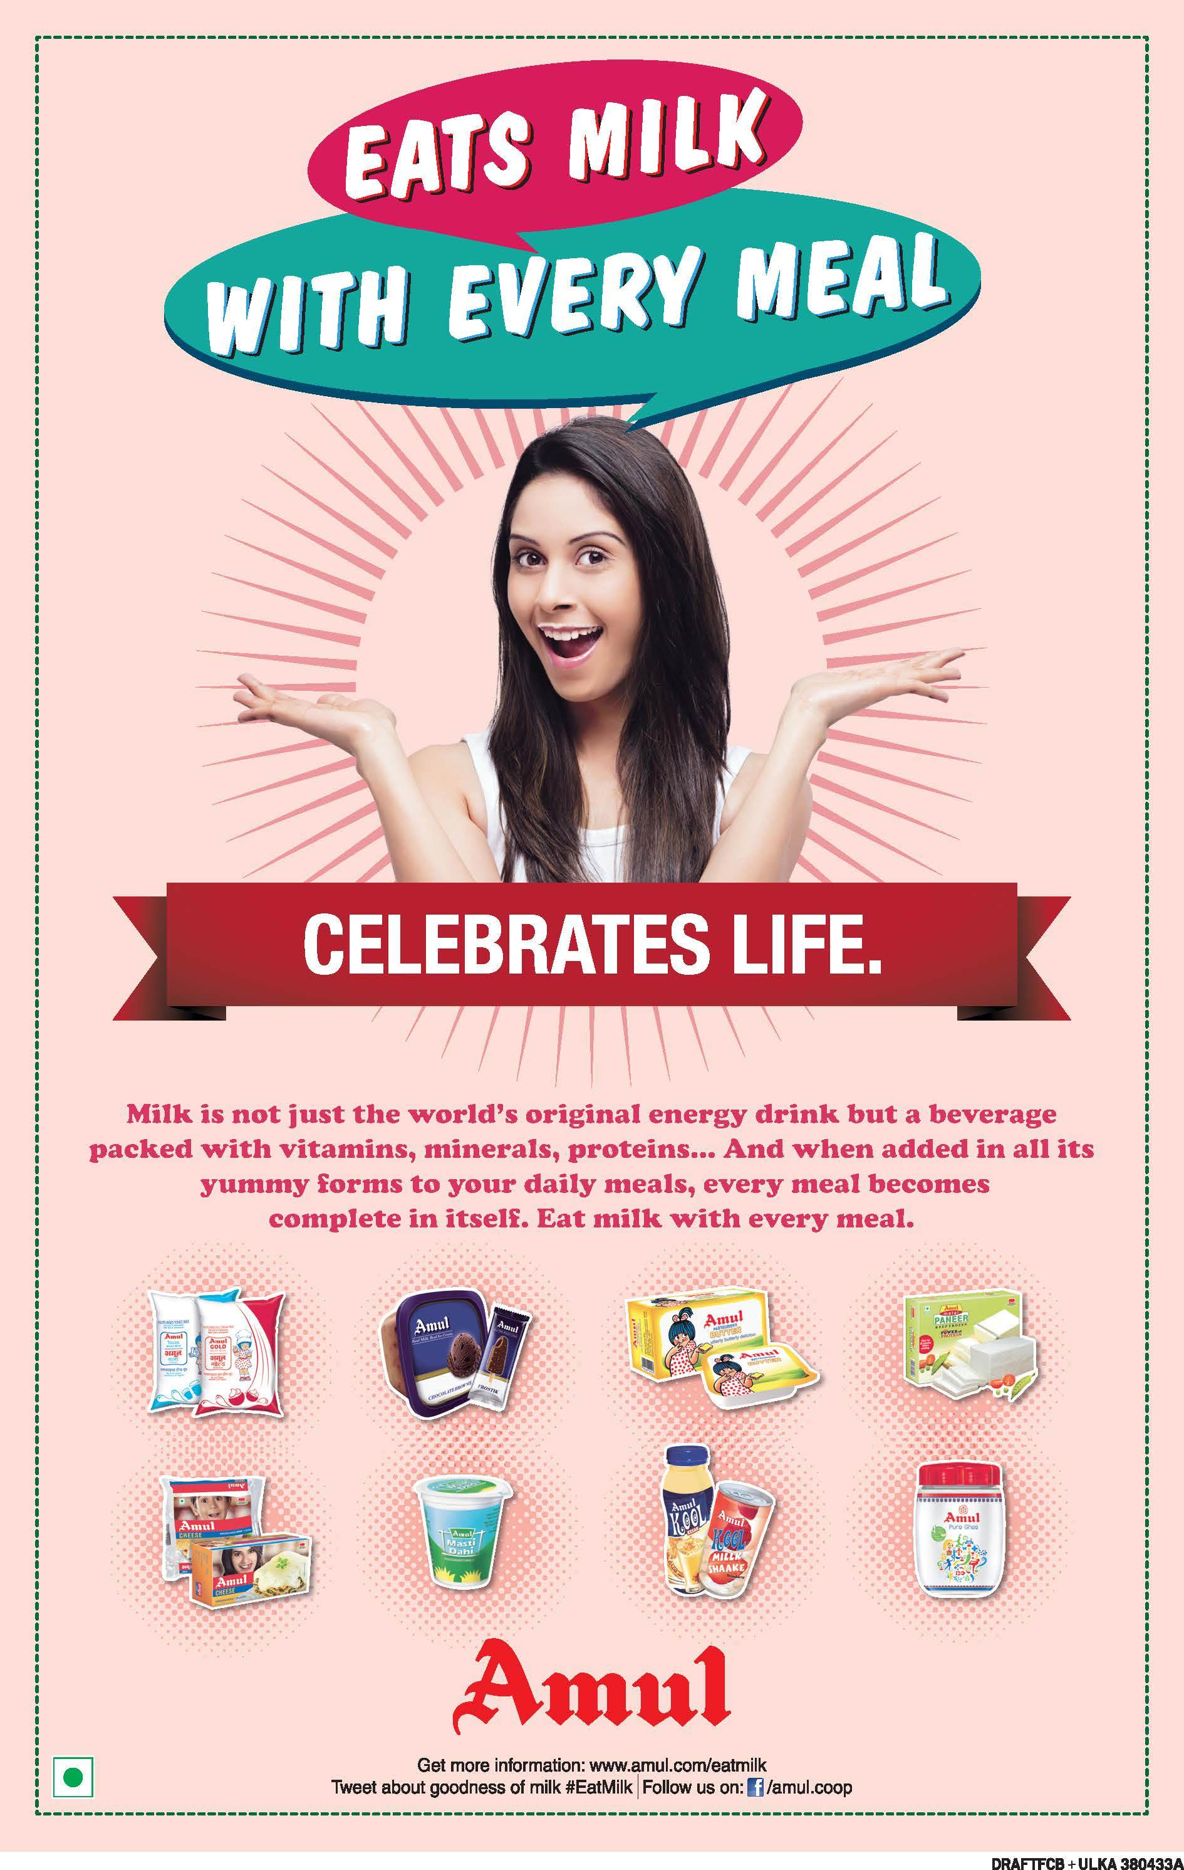
Amul
With a presence in almost every product which can be made by milk, Amul has won over hearts along with market share to become a highly valued brand with an Indian origin. The reason Amul is such a strong brand is because of the marketing mix of Amul.

Slide 23

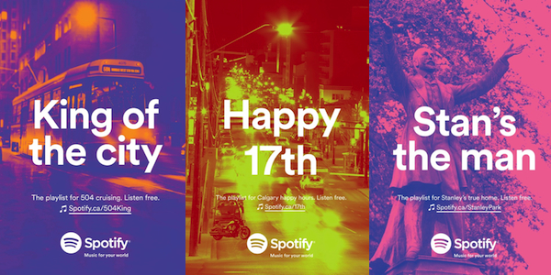
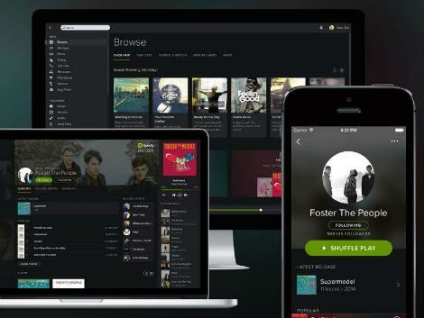
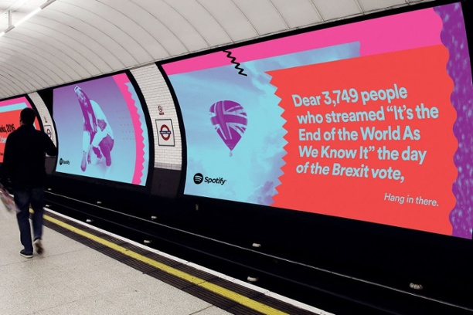
Spotify
Spotify’s largest ever campaign push which launched in November 2016 and spread across 14 markets worldwide is a perfect example of how data can drive creativity in marketing. Led by its in-house creative team, this innovative, global campaign was 100% fuelled by insights. Successfully placing a humorous spin on the ‘weird’ highlights of the previous year, the campaign proved the power that lies in creative marketing based on audience insights alone.

Slide 24
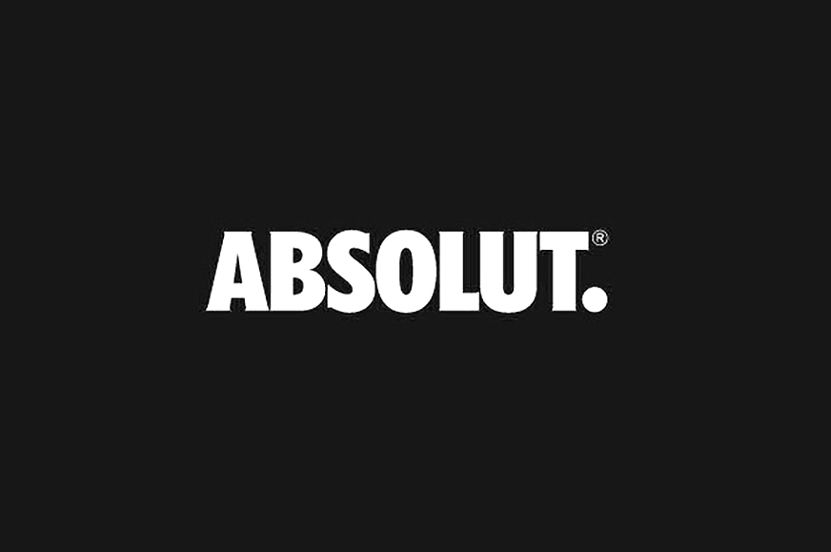
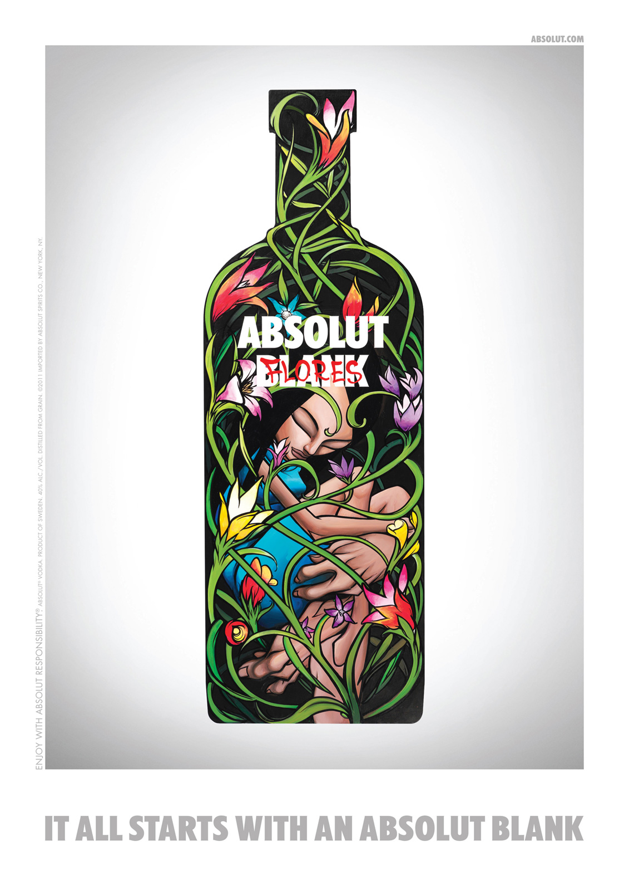
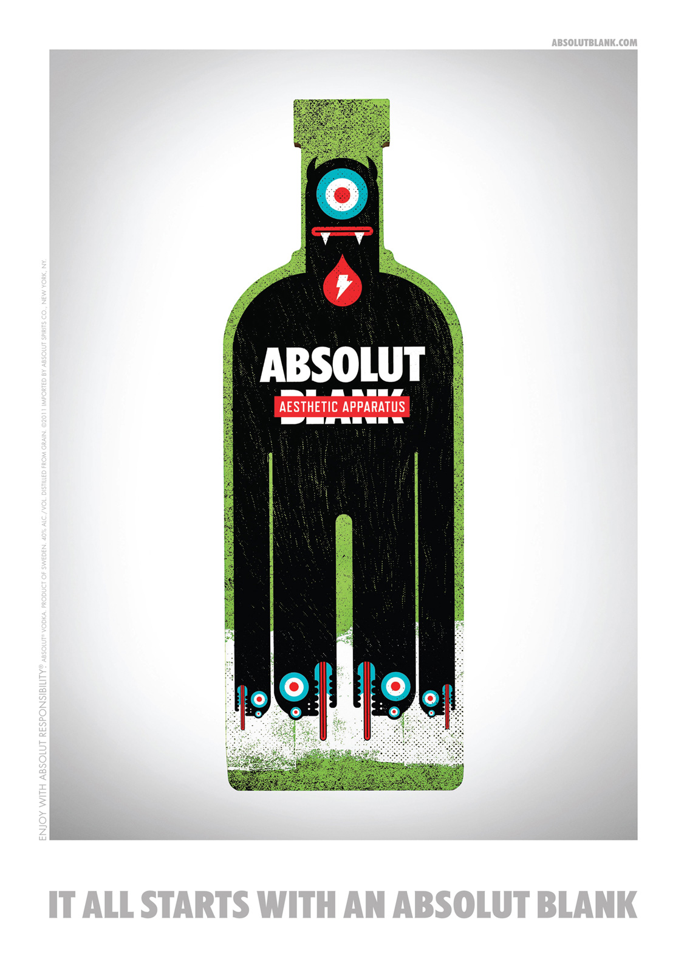
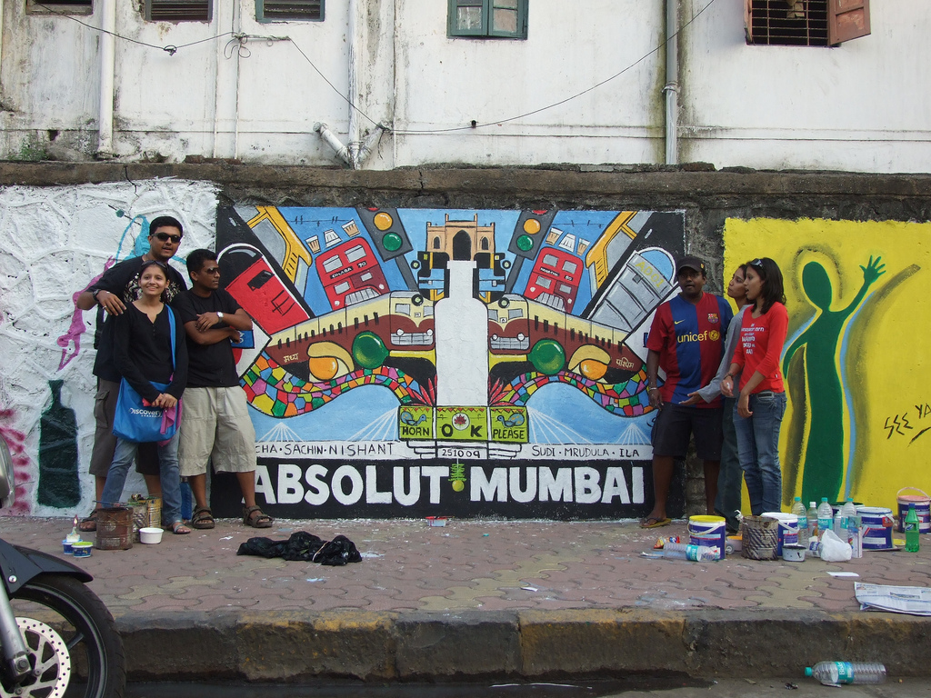
Absolut
Absolut intricately manages all marketing and manufacturing campaigns in order to serve people with the best. Unlike other contemporaries, Absolut takes pleasure in ensuring a classic experience for all its consumers. Absolut maintains its partly premium stand by ensuring that the products are delivered only to premium outlets.

Slide 25
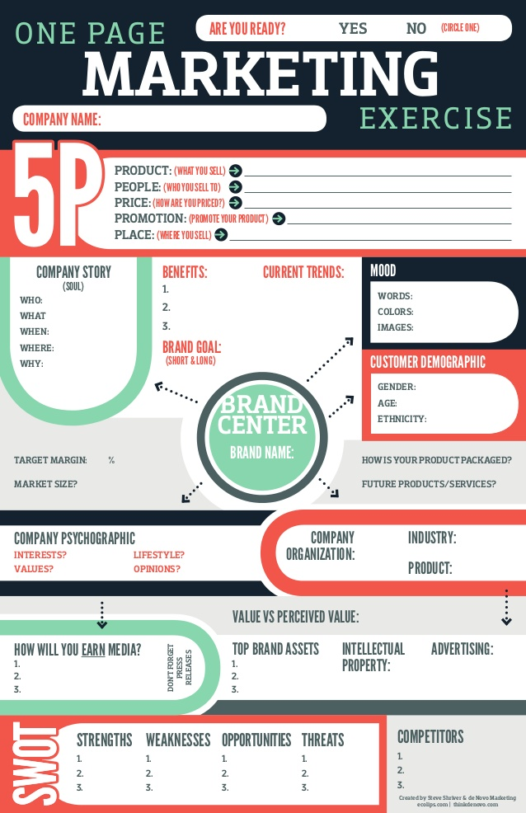

Slide 26
Visit the following link for further reading:
https://paste.ee/p/YVP69
*”www” not required

